Slide 1
Full Stack Application Development
Server Side: Implementing Web Services REST
REST Maturity Model
Akshaya Ganesan

Slide 2
REST Maturity Model
A REST Example

Slide 3
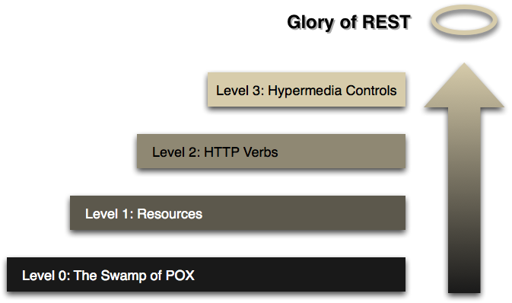
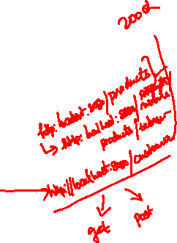
REST Maturity Model
Richardson used three main factors to decide the maturity of a service. These factors are
URI,
HTTP Methods,
HATEOAS (Hypermedia)
Richardson Maturity Model (martinfowler.com)

Slide 4
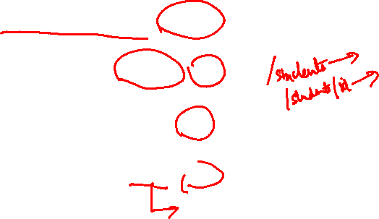
REST- Example
Lets say we have two resources
URI for a particular student with ID 123
URI for a particular course with ID 999
Student
Course
http://localhost/institute/students/123
http://localhost/institute/courses/999

Slide 5
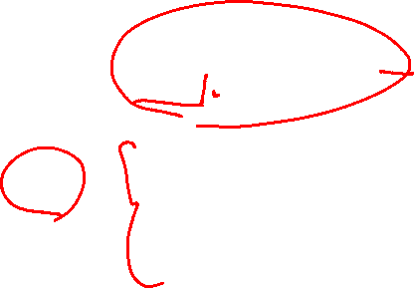
Example - CREATE
POST – to create a new resource
HTTP Method | URI | Operation
POST | http://localhost/institute/students Body { “Name” : “XYZ”, “ Year” : “First”, “DOB” : “25-04-1998” } | To create a new entry

Slide 6
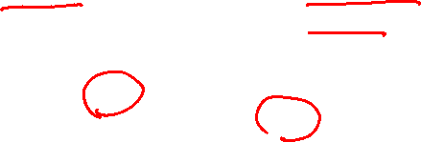
Example - GET
GET – retrieve the resource
HTTP Method | URI | Operation
GET | http://localhost/institute/students | For fetching information for all students
GET | http://localhost/institute/students/123 | For fetching the student having ID 123

Slide 7

Example - Update
PUT– update the resource
HTTP Method | URI | Operation
PUT | http://localhost/institute/students/123 Body { “Name” : “XYZ”, “ Year” : “Second”, “DOB” : “25-04-1998”, “Registered” : “Yes” } | For update the student record having ID as 123

Slide 8

Example - DELETE
DELETE– delete the resource
HTTP Method | URI | Operation
DELETE | http://localhost/institute/students/123 | For removing the student record having ID number 123

Slide 9
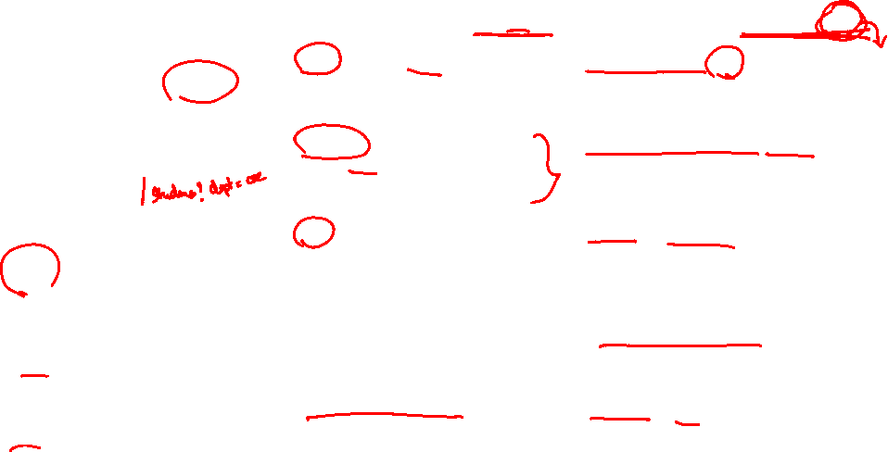
Using HTTP Methods for RESTful Services
HTTP Verb | CRUD | Entire Collection (e.g. /students) | Specific Item (e.g. /students/{id})
POST | Create | 201 (Created), 'Location' header with link to /students/containing new ID. | 404 (Not Found), 409 (Conflict) if resource already exists..
GET | Read | 200 (OK), list of student. Use pagination, sorting and filtering to navigate big lists. | 200 (OK), single student. 404 (Not Found), if ID not found or invalid.
PUT | Update/Replace | 405 (Method Not Allowed), unless you want to update/replace every resource in the entire collection. | 200 (OK) or 204 (No Content). 404 (Not Found), if ID not found or invalid.
PATCH | Update/Modify | 405 (Method Not Allowed), unless you want to modify the collection itself. | 200 (OK) or 204 (No Content). 404 (Not Found), if ID not found or invalid.
DELETE | Delete | 405 (Method Not Allowed), unless you want to delete the whole collection—not often desirable. | 200 (OK). 404 (Not Found), if ID not found or invalid.

Slide 10
REST Maturity Model

Slide 11
Thank You!

